Slide 1





Object Oriented Programming (OOP)

Slide 2

Hello!
I am Eslam Ahmed
I am a software engineer.
You can find me at jeksogsa@gmail.com

Slide 3



Why OOP ?!
Let’s see Why ^_^

Slide 4
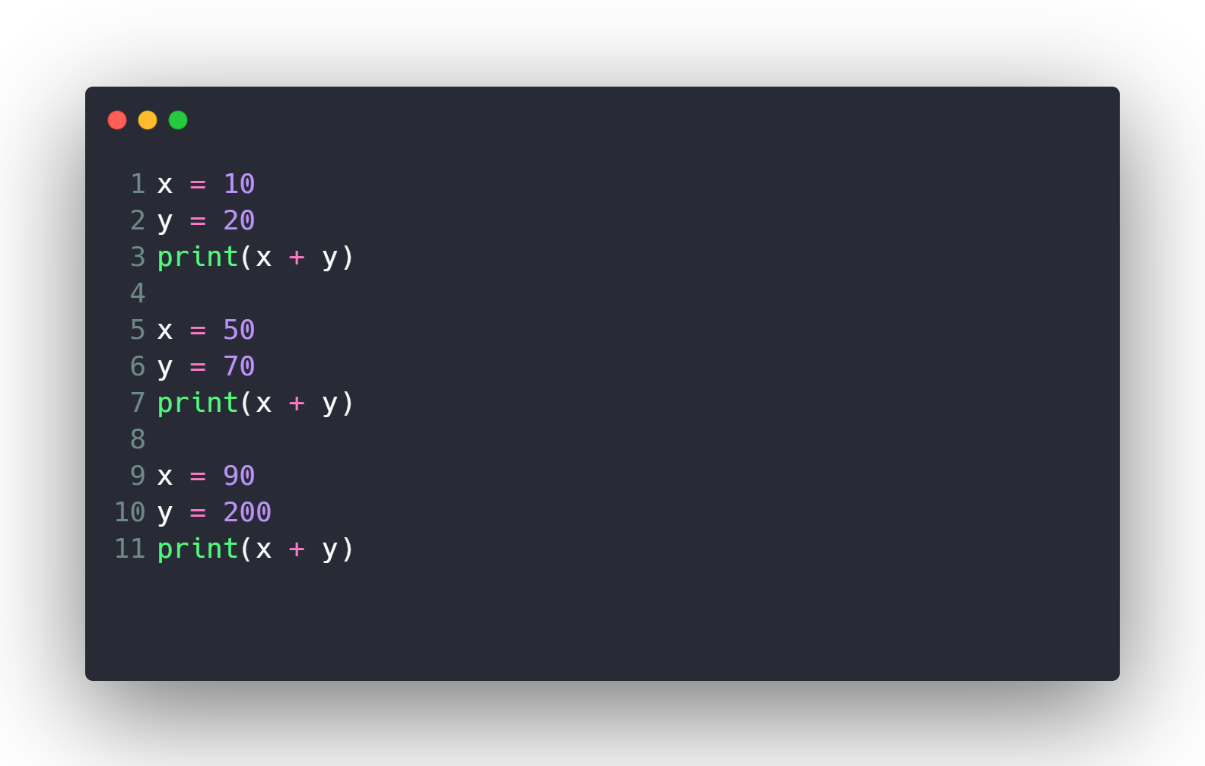
Calculate Sum 10000 times ?!

Slide 5

Calculate Sum 10000 times ?!
What if I want to modify code to multiply ?

Slide 6
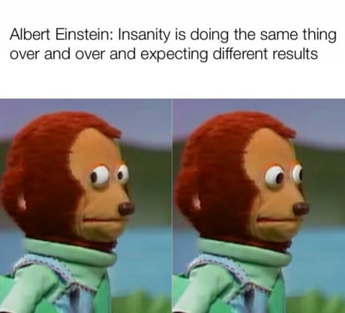
Calculate Sum 10000 times ?!
What if I want to modify code to multiply ?

Slide 7
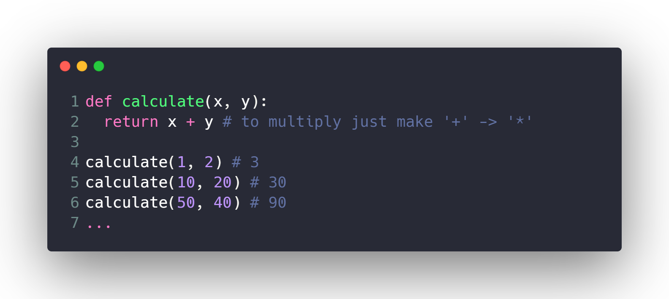
Calculate Sum 10000 times ?!
What if I want to modify code to multiply ?
Much Better ^_^

Slide 8
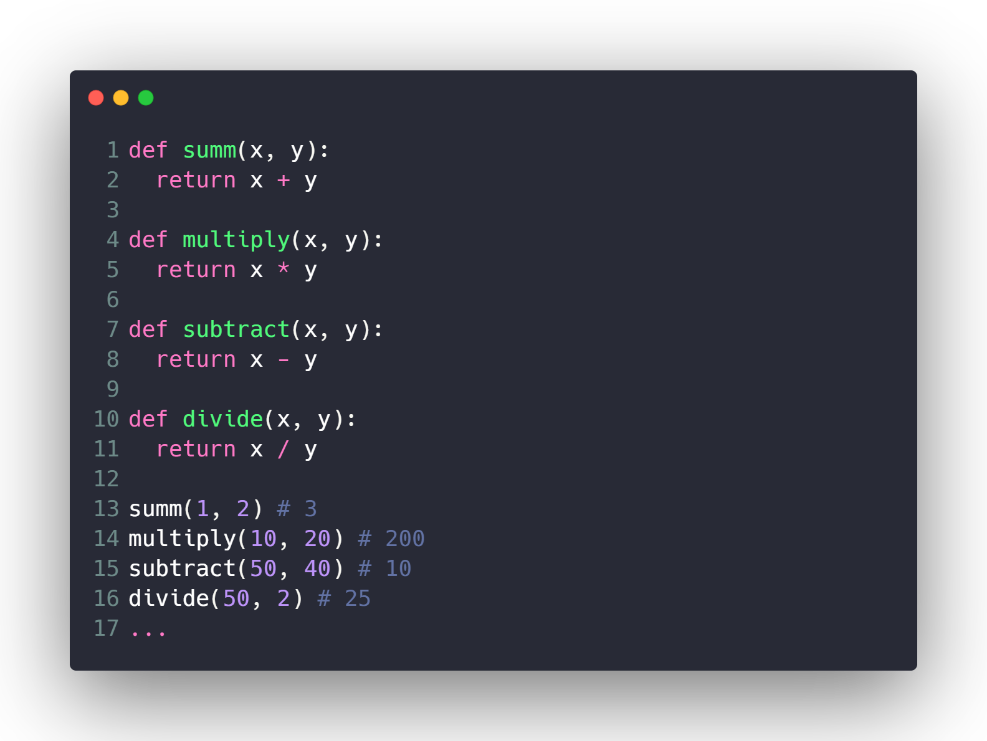
Make Full Calculator ?

Slide 9
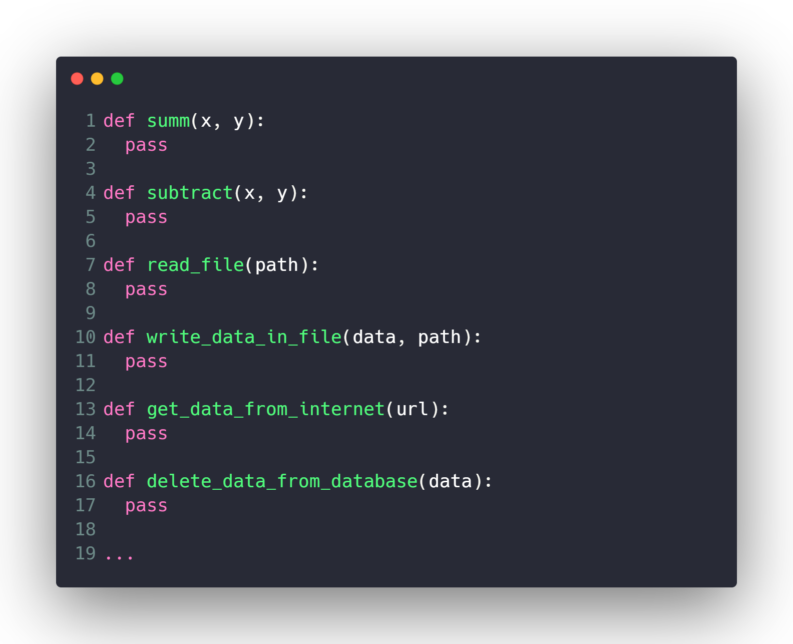
Make Lots of Features ?

Slide 10

Make Lots of Features ?

Slide 11








What is OOP ?!
Everything is an
Object

Slide 12
Dog
Properties
Size
Color
Breed
Age
…
Methods
Run()
Park()
Eat()
Sleep()
…

Slide 13
Car
Properties
Model
Color
Plate Number
Speed
…
Methods
Move_Forward()
Move_Backward()
Break()
Throttle()
…

Slide 14
Person
Properties
Name
Age
Address
Gender
…
Methods
Eat()
Sleep()
Walk()
Pray()
…

Slide 15
Camera
Properties
Lens_width
Has_Flash
Depth
…
Methods
Take_Photo()
Take_Video()
Toggle_Flash()
Zoom()
…

Slide 16
Machine Learning Model
Properties
Name
Learning_rate
Num_of_iterations
Weights
…
Methods
fit()
predict()
…

Slide 17
Classes & Objects

Slide 18
Person
Properties
Name
Age
Address
Gender
…
Methods
Eat()
Sleep()
Walk()
Pray()
…

Slide 19
Class: Person
Object 1
Name: Eslam
Age: 26
Gender: Male
Eat Meat
Sleep at 9 pm
Object 2
Name: Ahmed
Age: 15
Gender: Male
Eat Chicken
Sleep at 12 am
Object 3
Name: Sara
Age: 30
Gender: Female
Eat Fish
Sleep at 6 am

Slide 20
Machine Learning Model
Properties
Name
Learning_rate
Num_of_iterations
Weights
…
Methods
fit()
predict()
…

Slide 21
Class: Machine Learning Model
Object 1
Name: Linear Regression
…
Fit()
Predict()
Object 2
Name: SVM
…
Fit()
Predict()

Slide 22
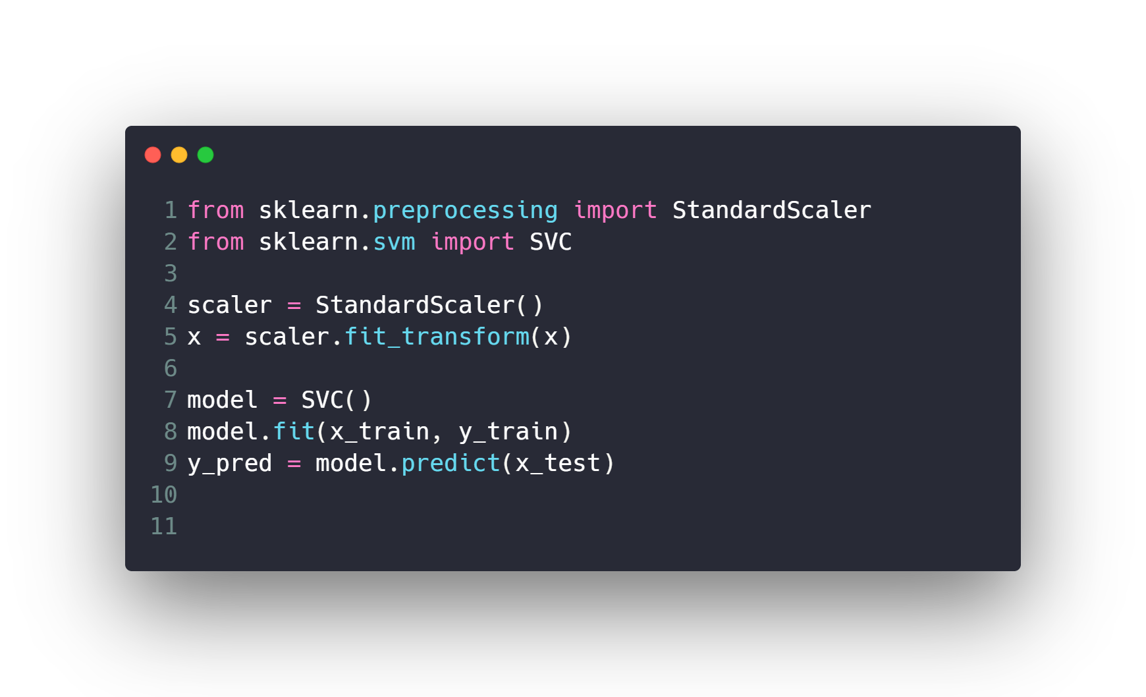
Example of Classes & Objects in Python ?

Slide 23
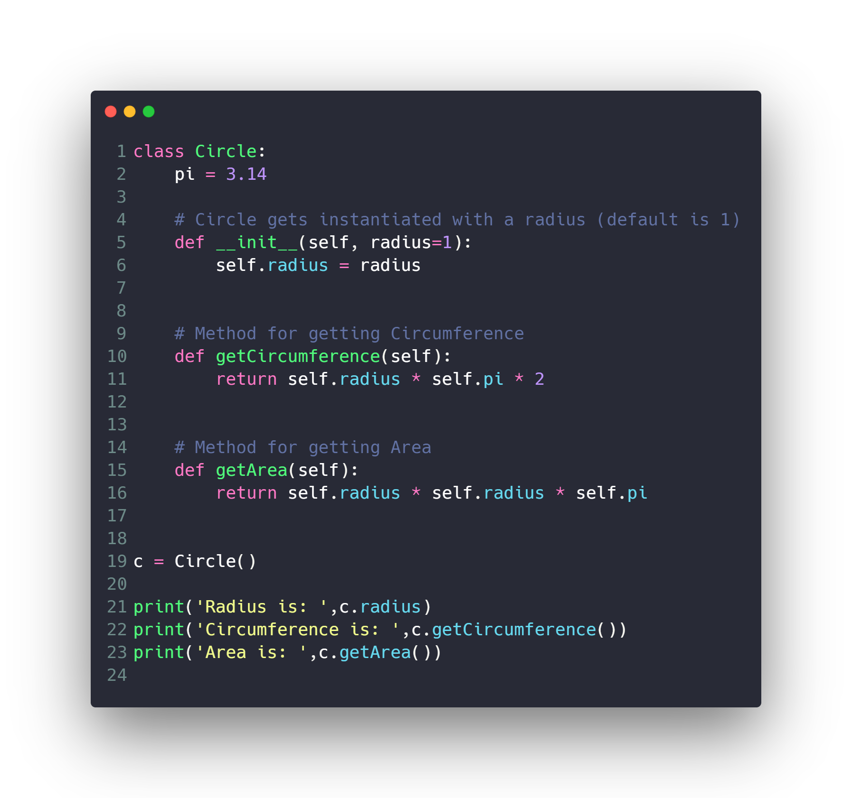
OOP in Python ?
Circle

Slide 24
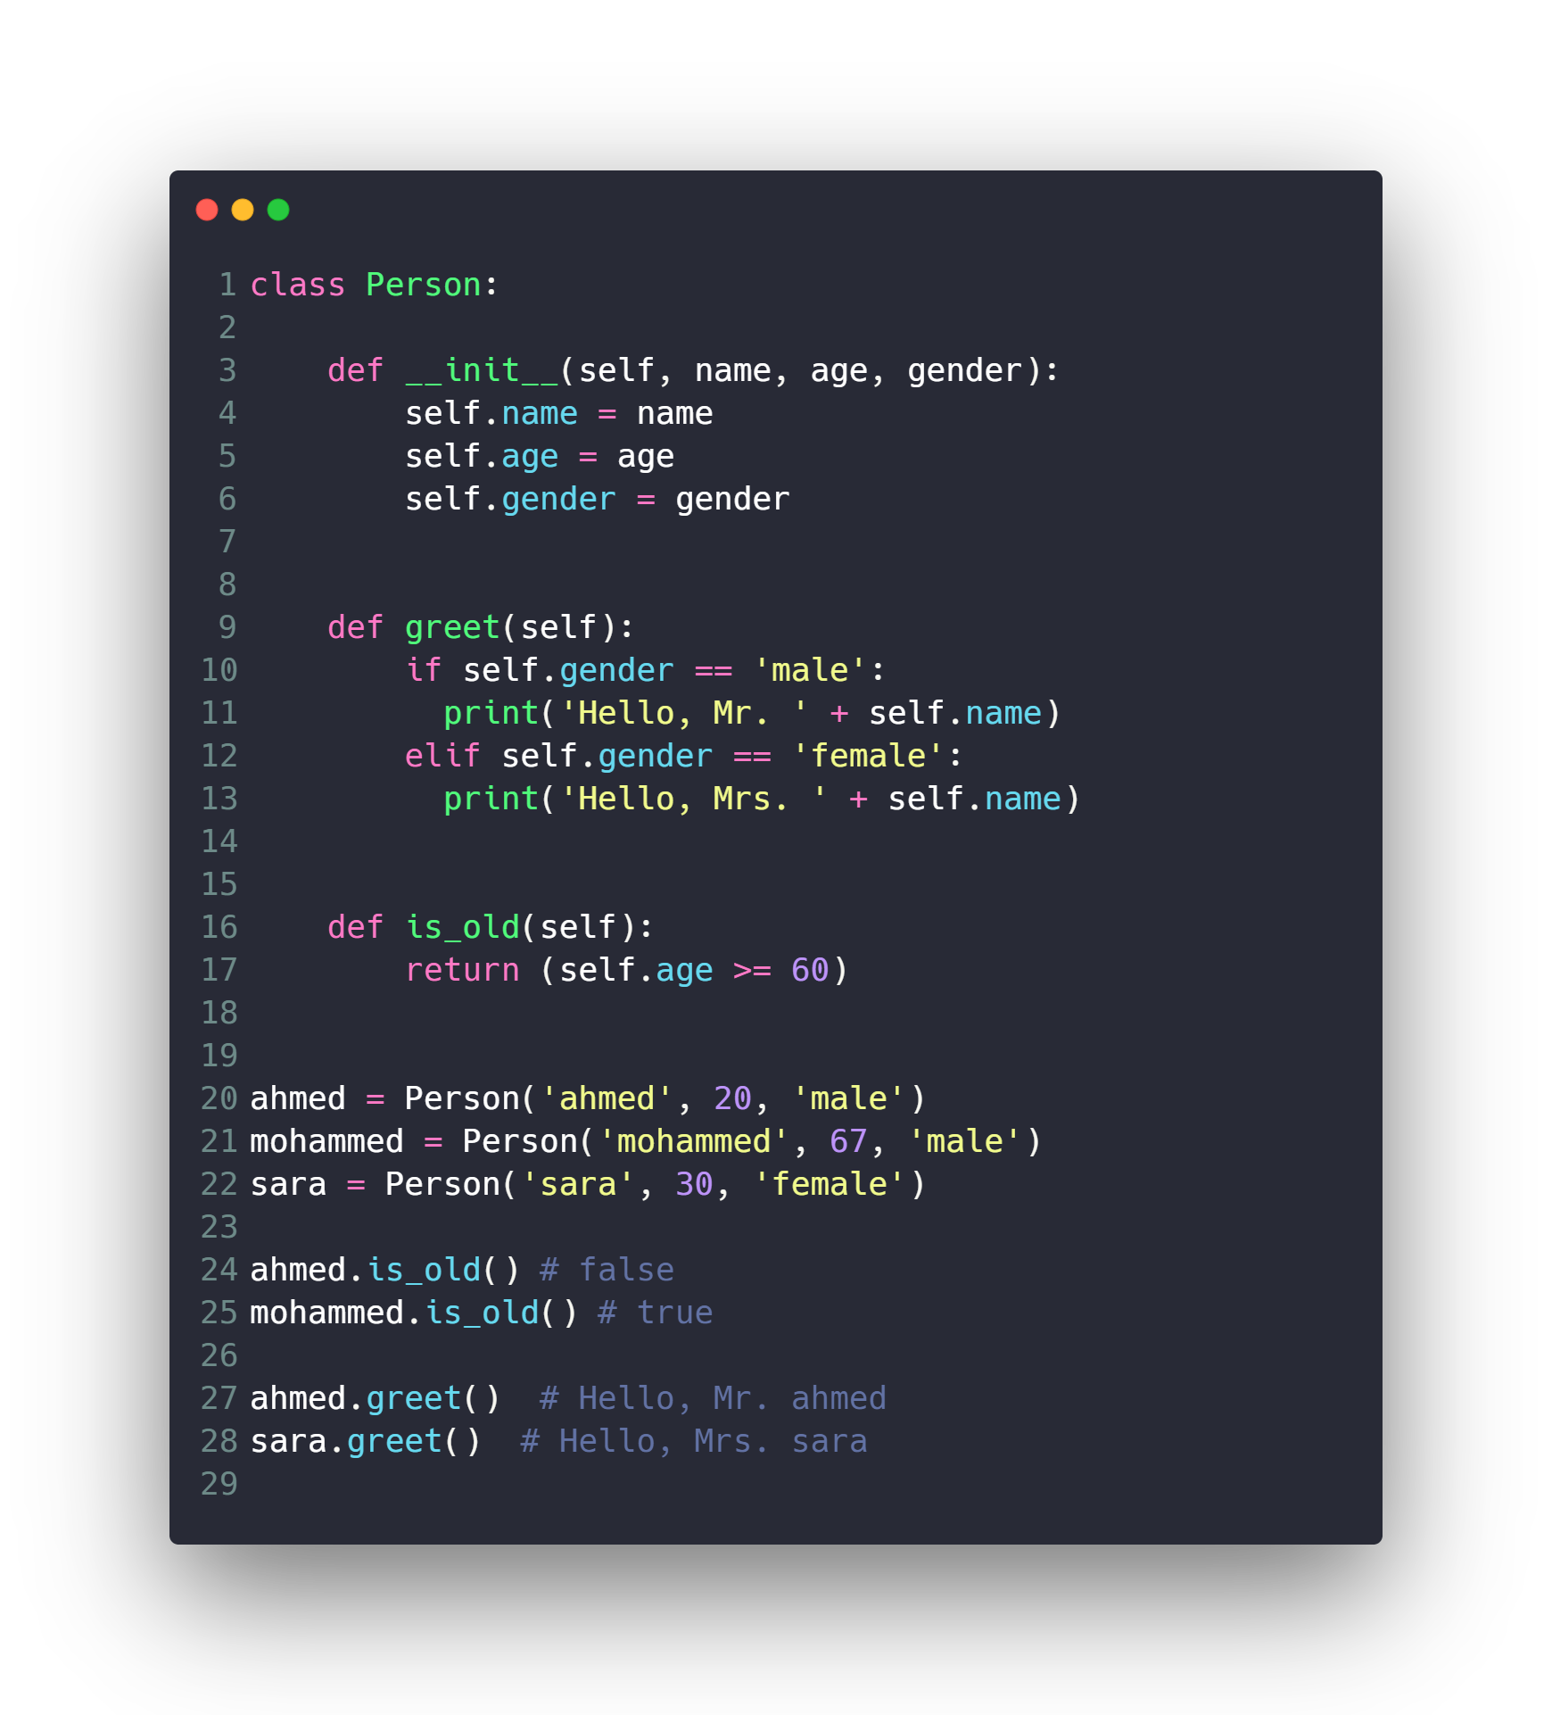
OOP in Python ?
Person

Slide 25
OOP Concepts
Data Hiding (Encapsulation)
Inheritance
Polymorphism
Special Functions and Operators Overloading

Slide 26
Data Hiding (Encapsulation)

Slide 27
Data Hiding (Encapsulation)
An object's attributes may or may not be visible outside the class definition. You need to name attributes with a double underscore prefix, and those attributes then are not be directly visible to outsiders.

Slide 28
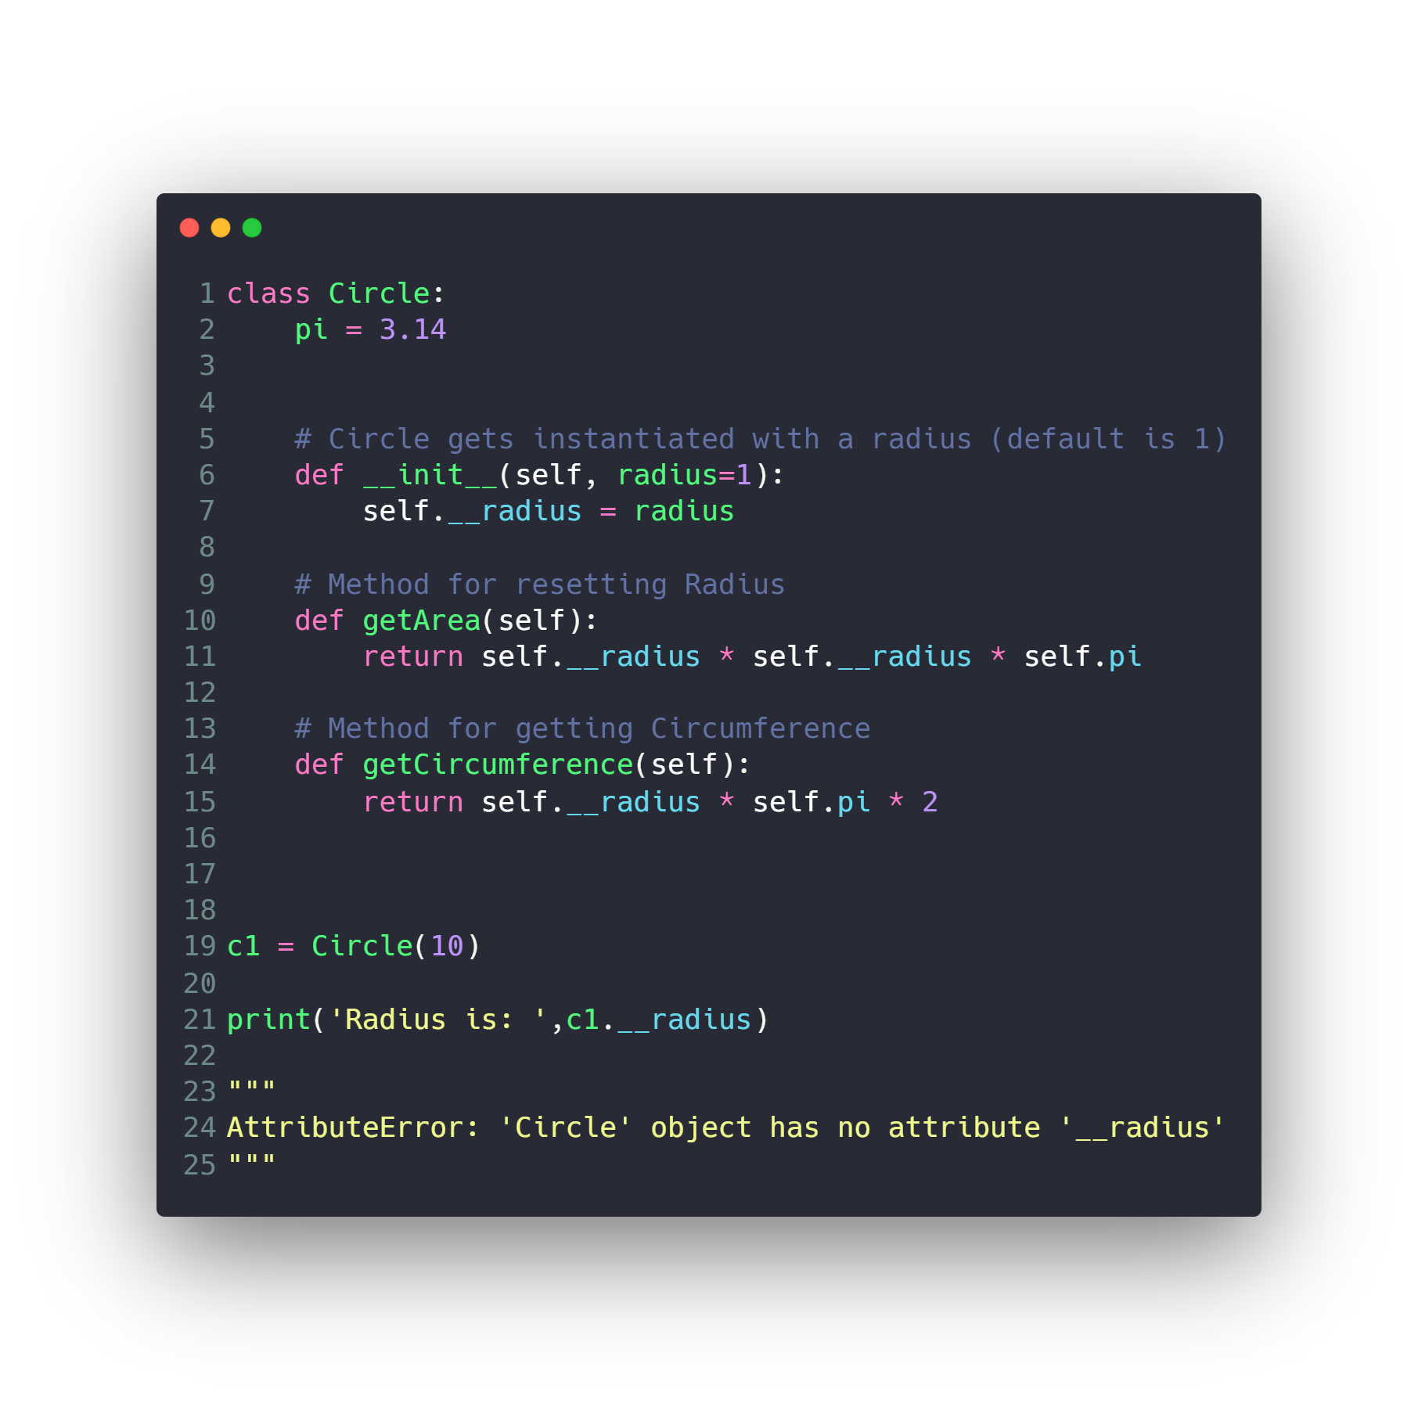
Data Hiding (Encapsulation)

Slide 29
OOP Concepts
Data Hiding (Encapsulation)
Inheritance
Polymorphism
Special Functions and Operators Overloading

Slide 30
Inheritance

Slide 31
Inheritance
It is a way to form new classes using classes that have already been defined. The newly formed classes are called derived classes, the classes that we derive from are called base classes.

Slide 32
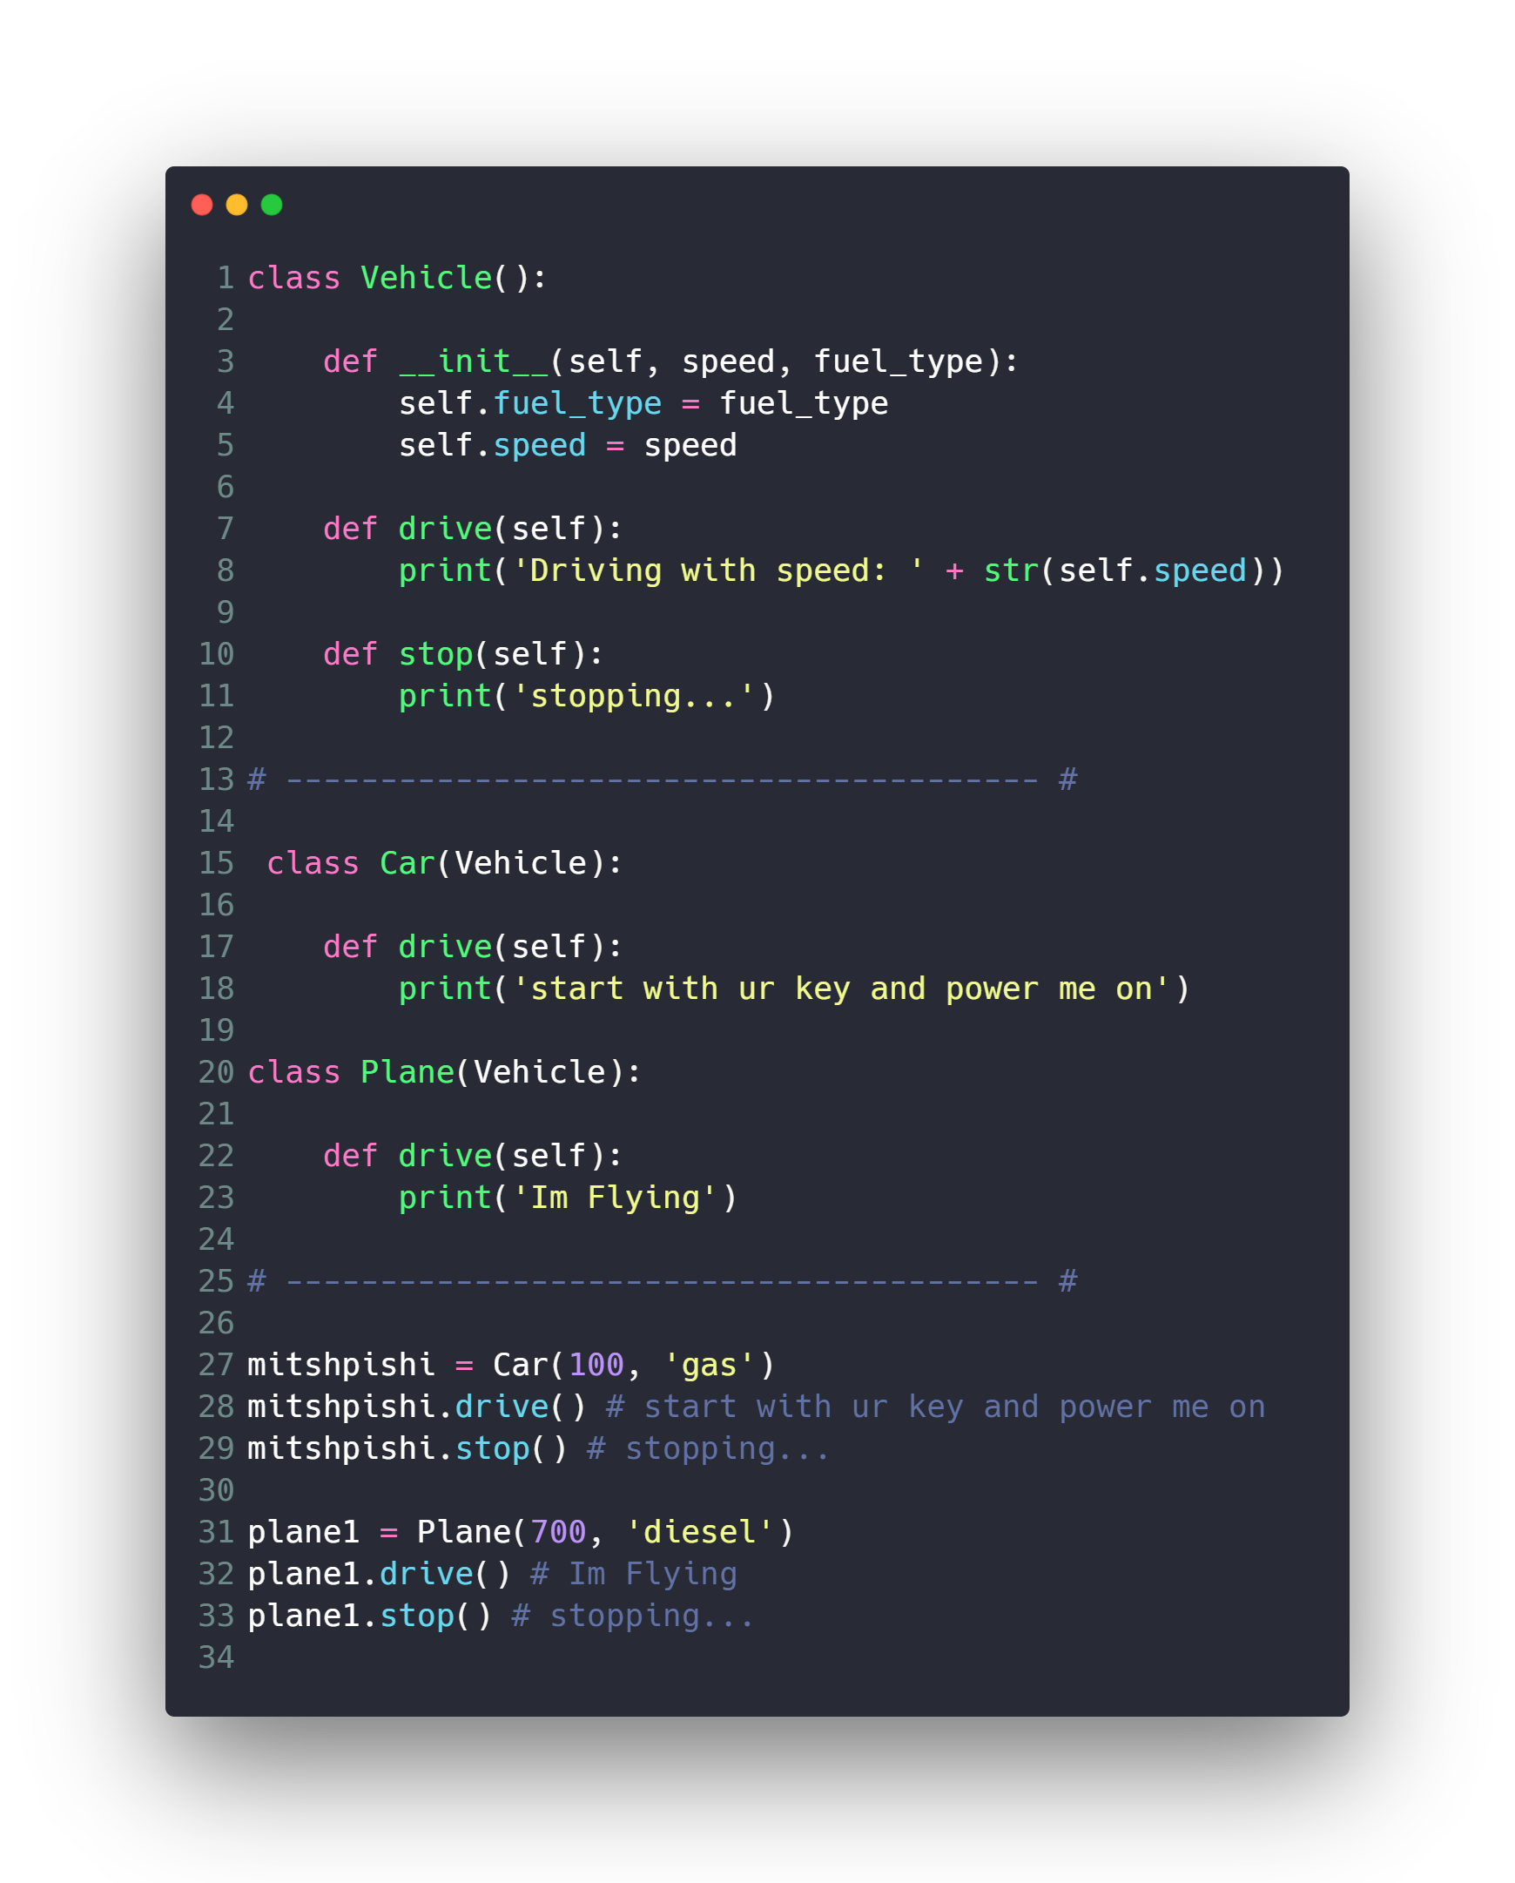
Inheritance

Slide 33
OOP Concepts
Data Hiding (Encapsulation)
Inheritance
Polymorphism
Special Functions and Operators Overloading

Slide 34
Polymorphism

Slide 35
Polymorphism
polymorphism refers to the way in which different object classes can share the same method name but each acts differently.

Slide 36
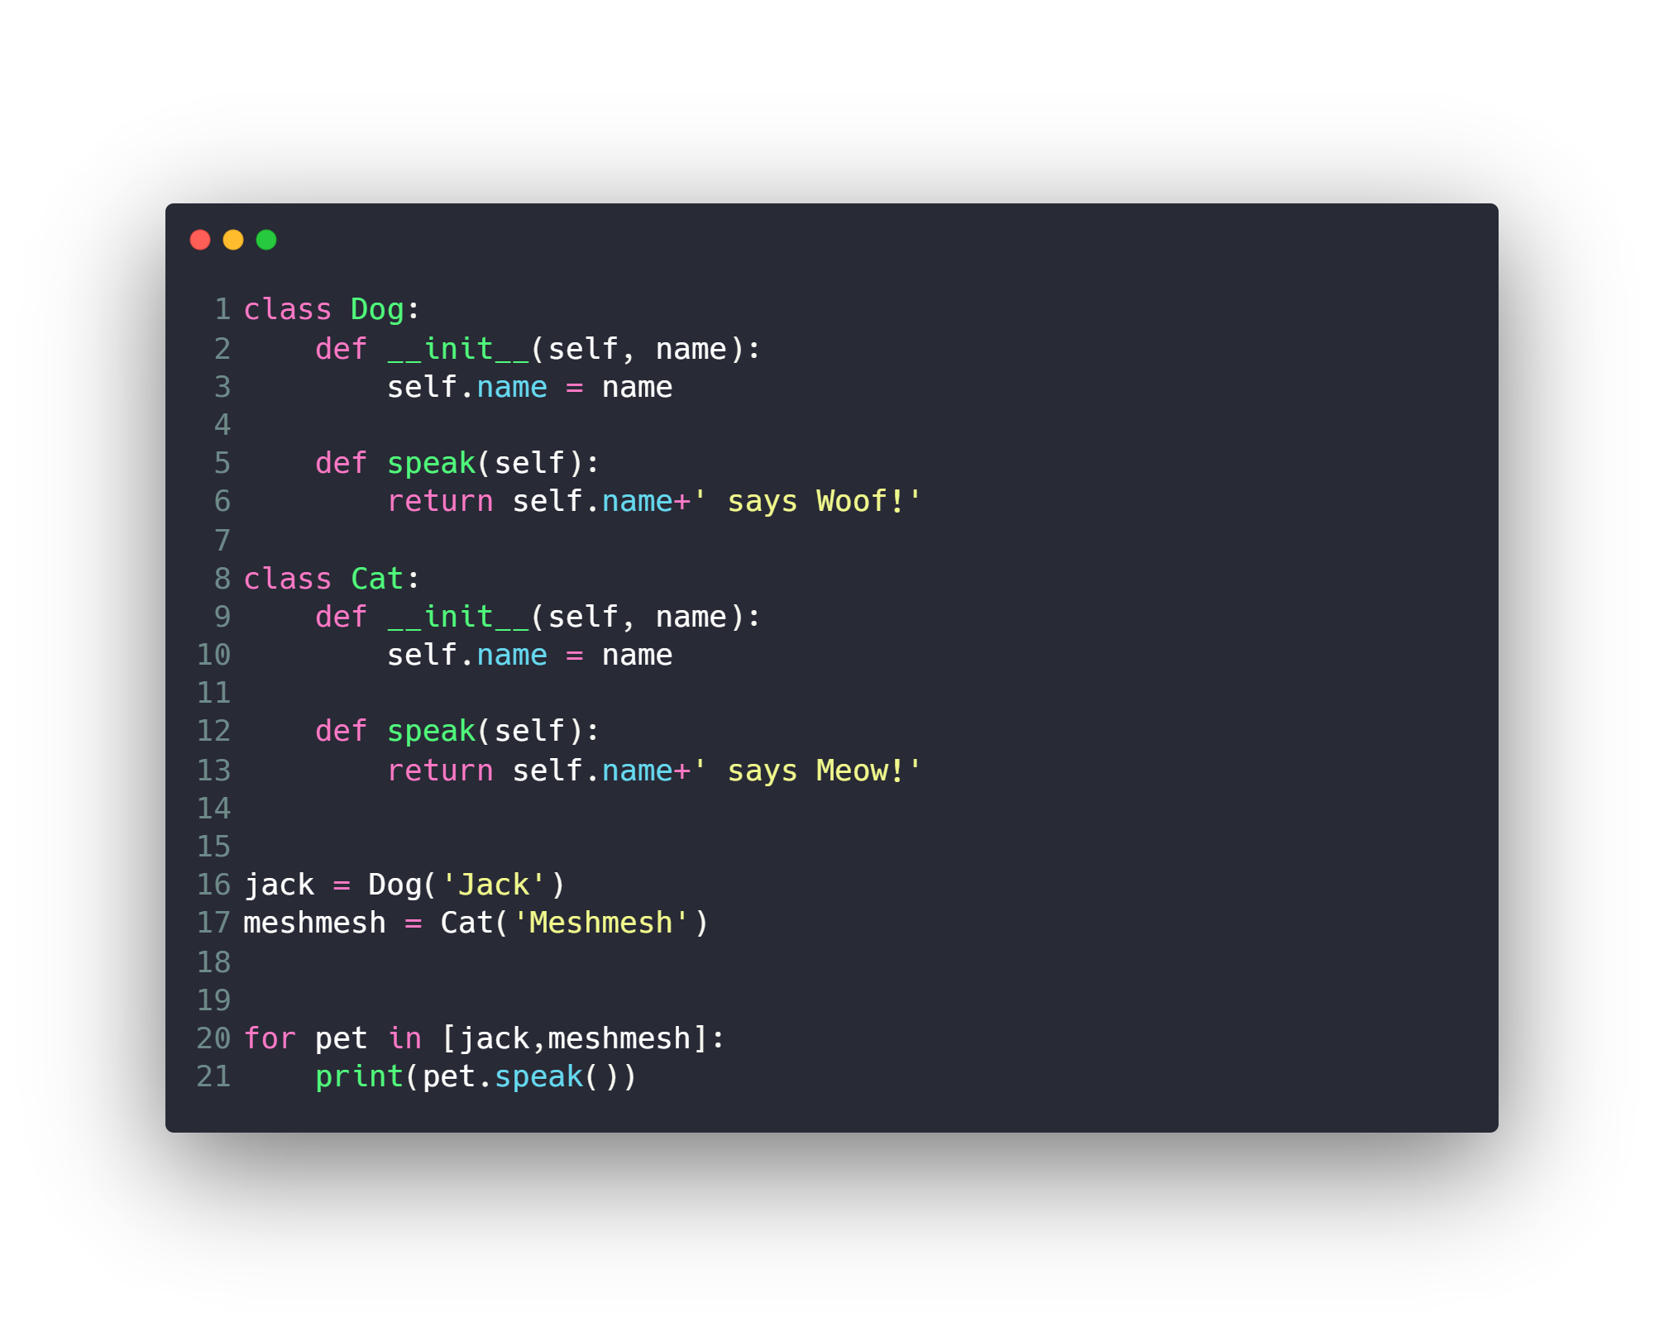
Polymorphism

Slide 37
OOP Concepts
Data Hiding (Encapsulation)
Inheritance
Polymorphism
Special Functions and Operators Overloading

Slide 38
Special Functions and Operators Overloading
Math Operator
Comparison Operator
__add__
__sub__
__mul__
__truediv__
__floordiv__
__mod__
__pow__
__eq__
__nq__
__lt__
__le__
__gt__
__ge__

Slide 39
Special Functions and Operators Overloading
Other Operators
__init__
__str__
…

Slide 40
Other Concepts
Exceptions
Decorators
Iterators and Generators

Slide 41
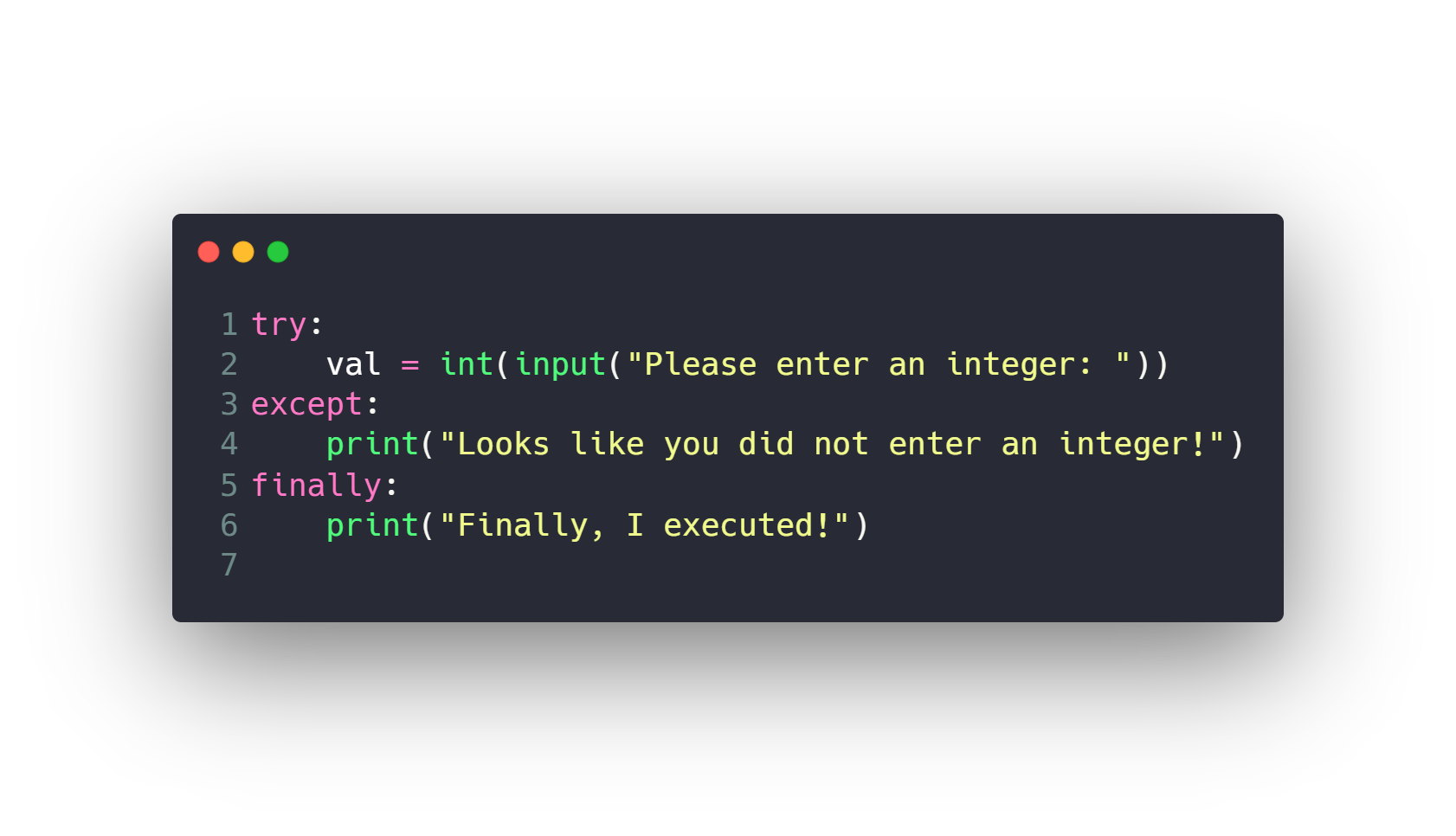
Exceptions
https://www.tutorialsteacher.com/python/error-types-in-python

Slide 42
Other Concepts
Exceptions
Decorators
Iterators and Generators

Slide 43
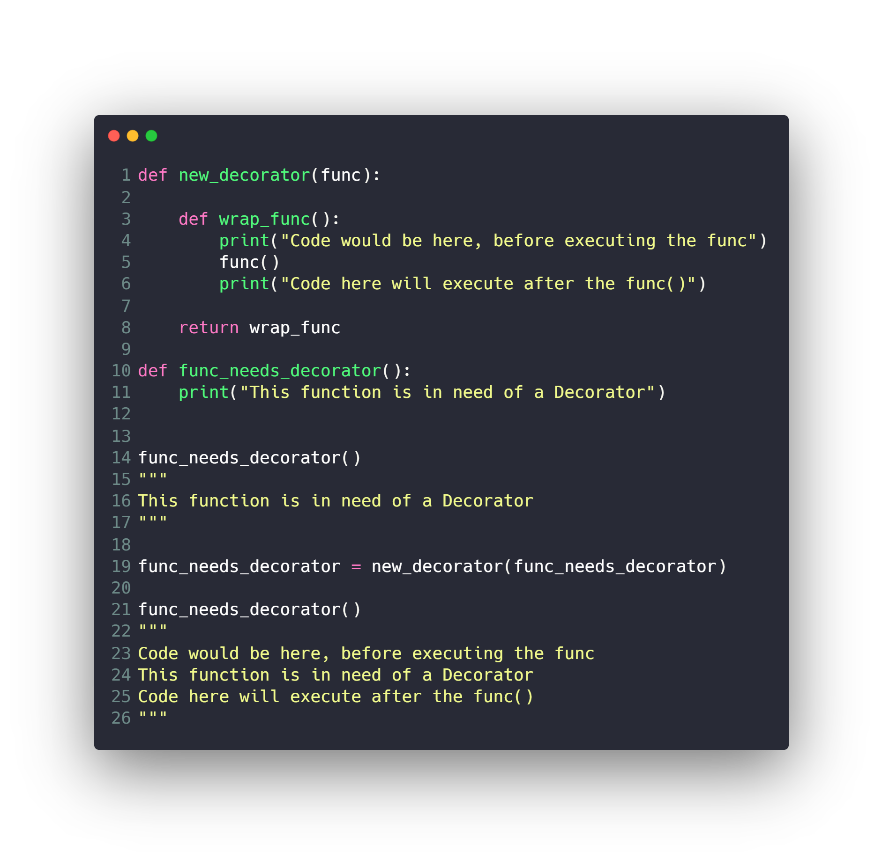
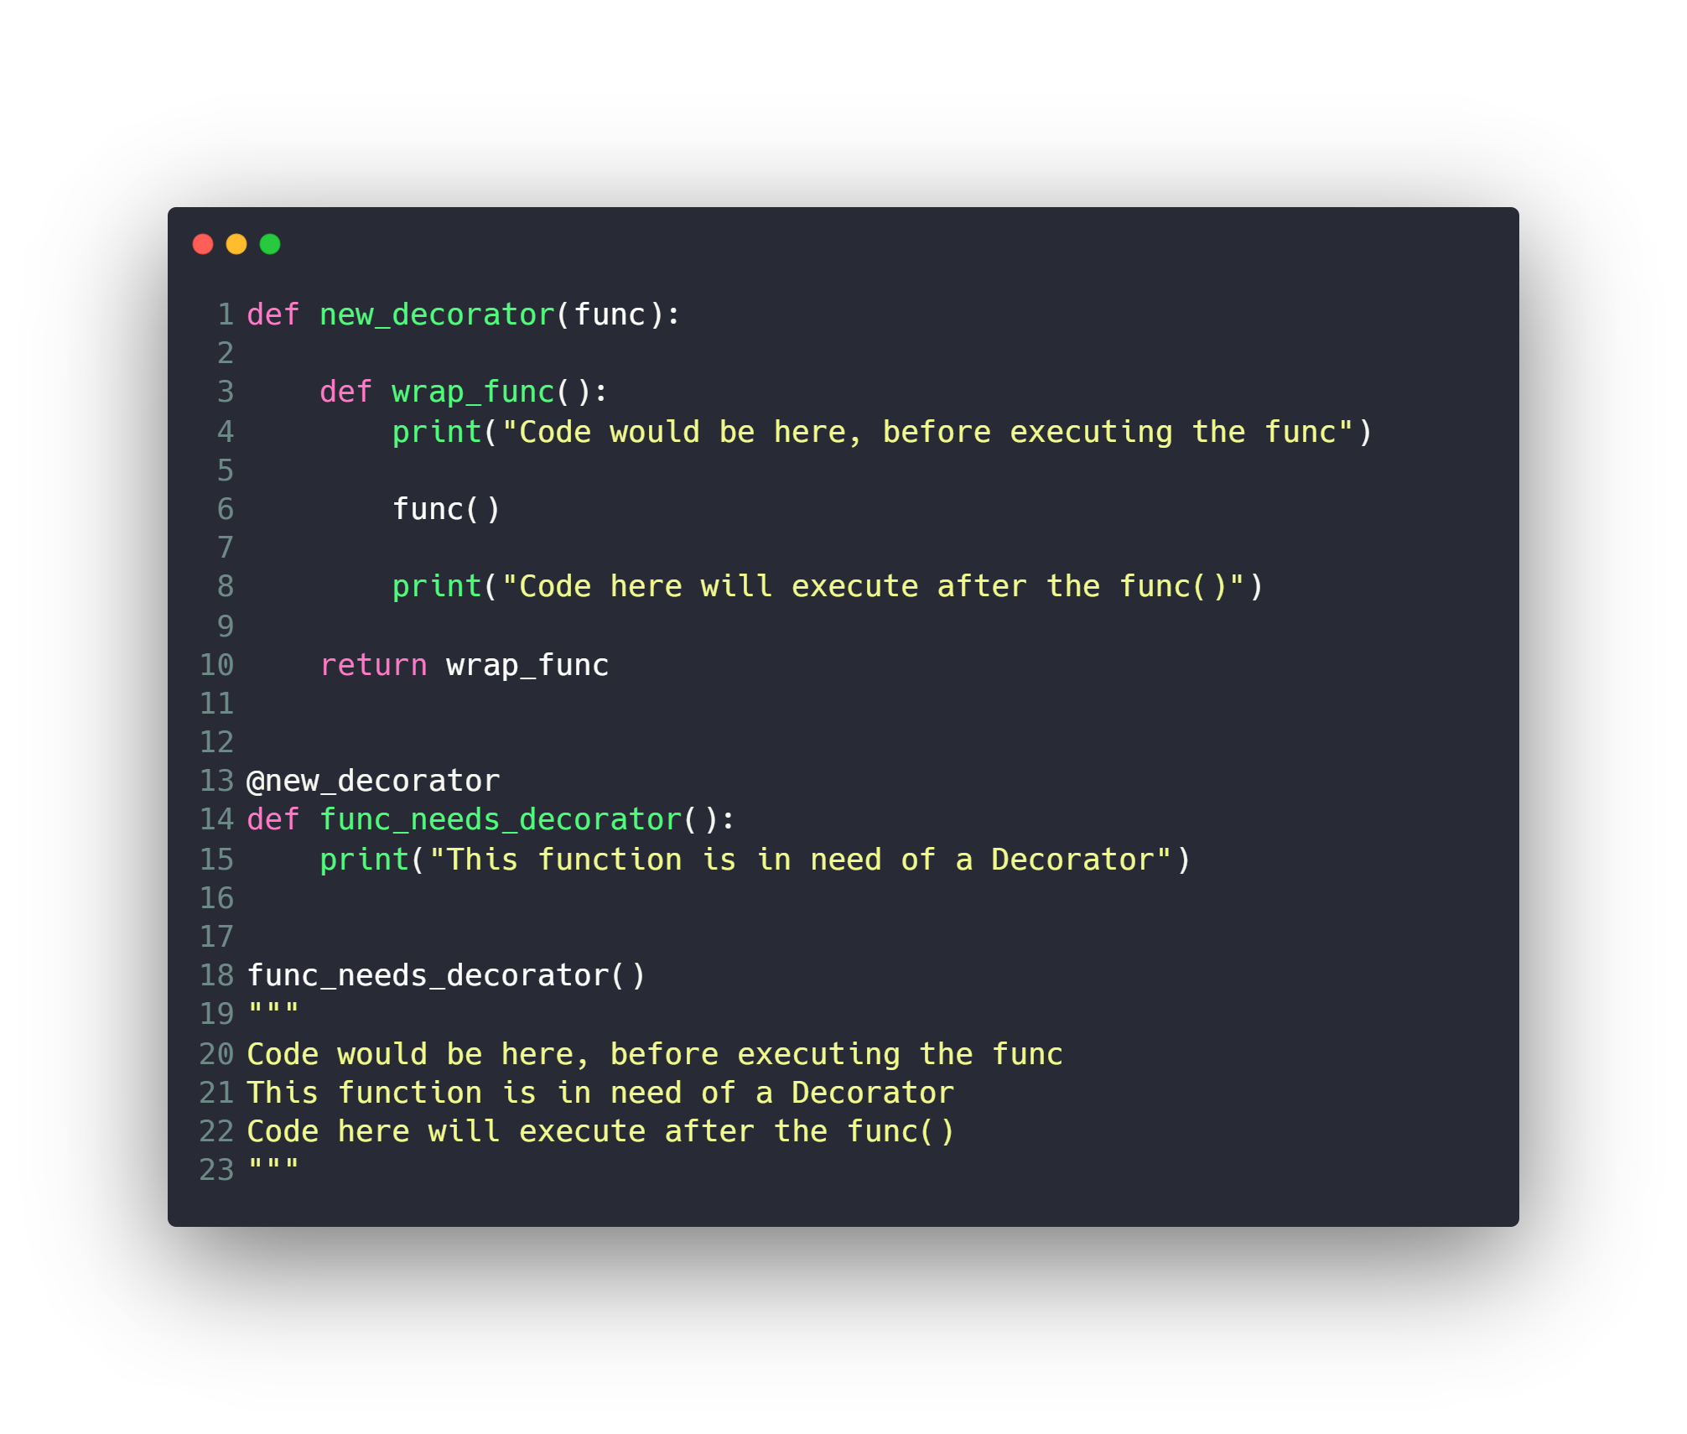
Decorators

Slide 44
Other Concepts
Exceptions
Decorators
Iterators and Generators

Slide 45
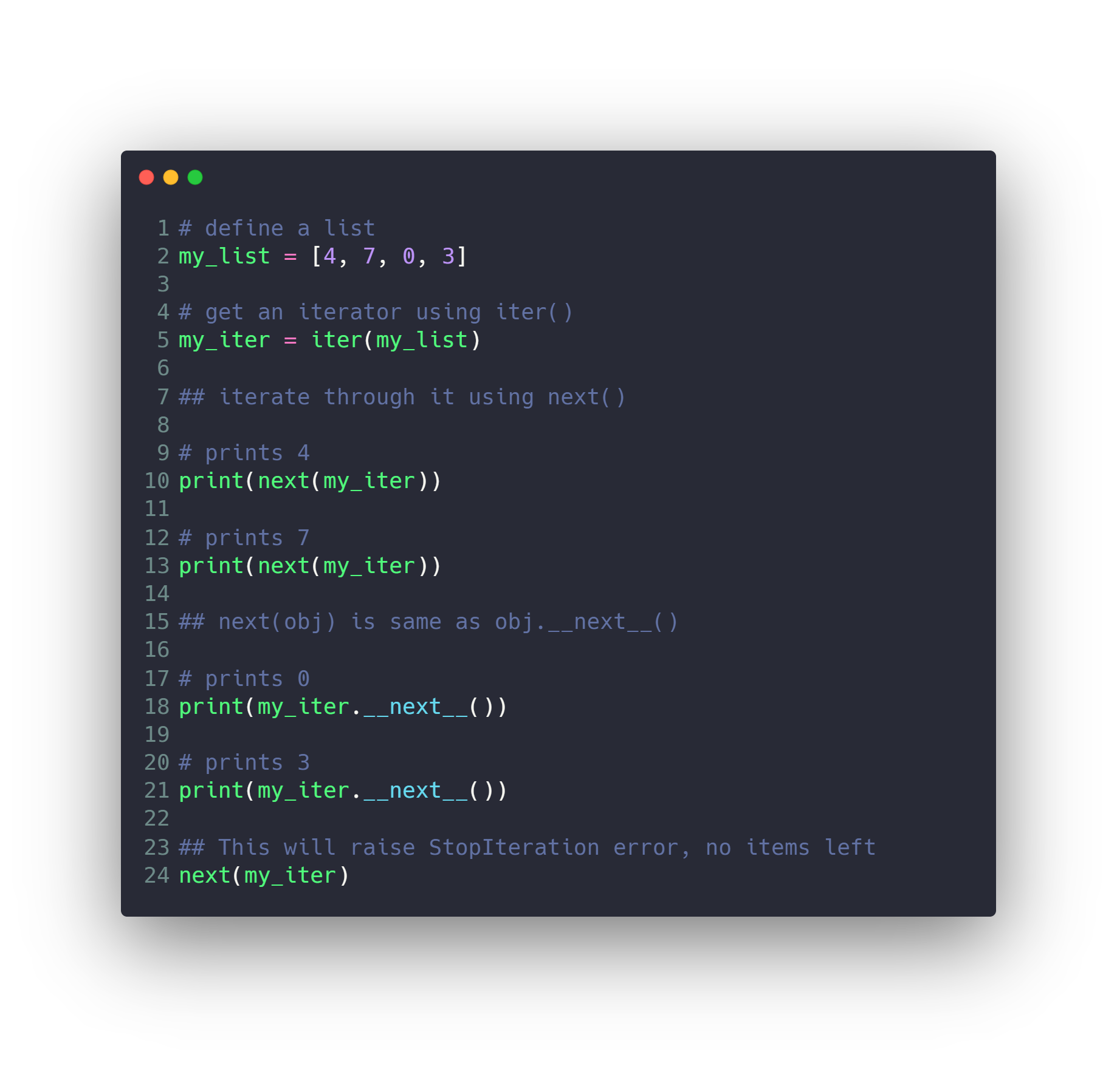
Iterators

Slide 46
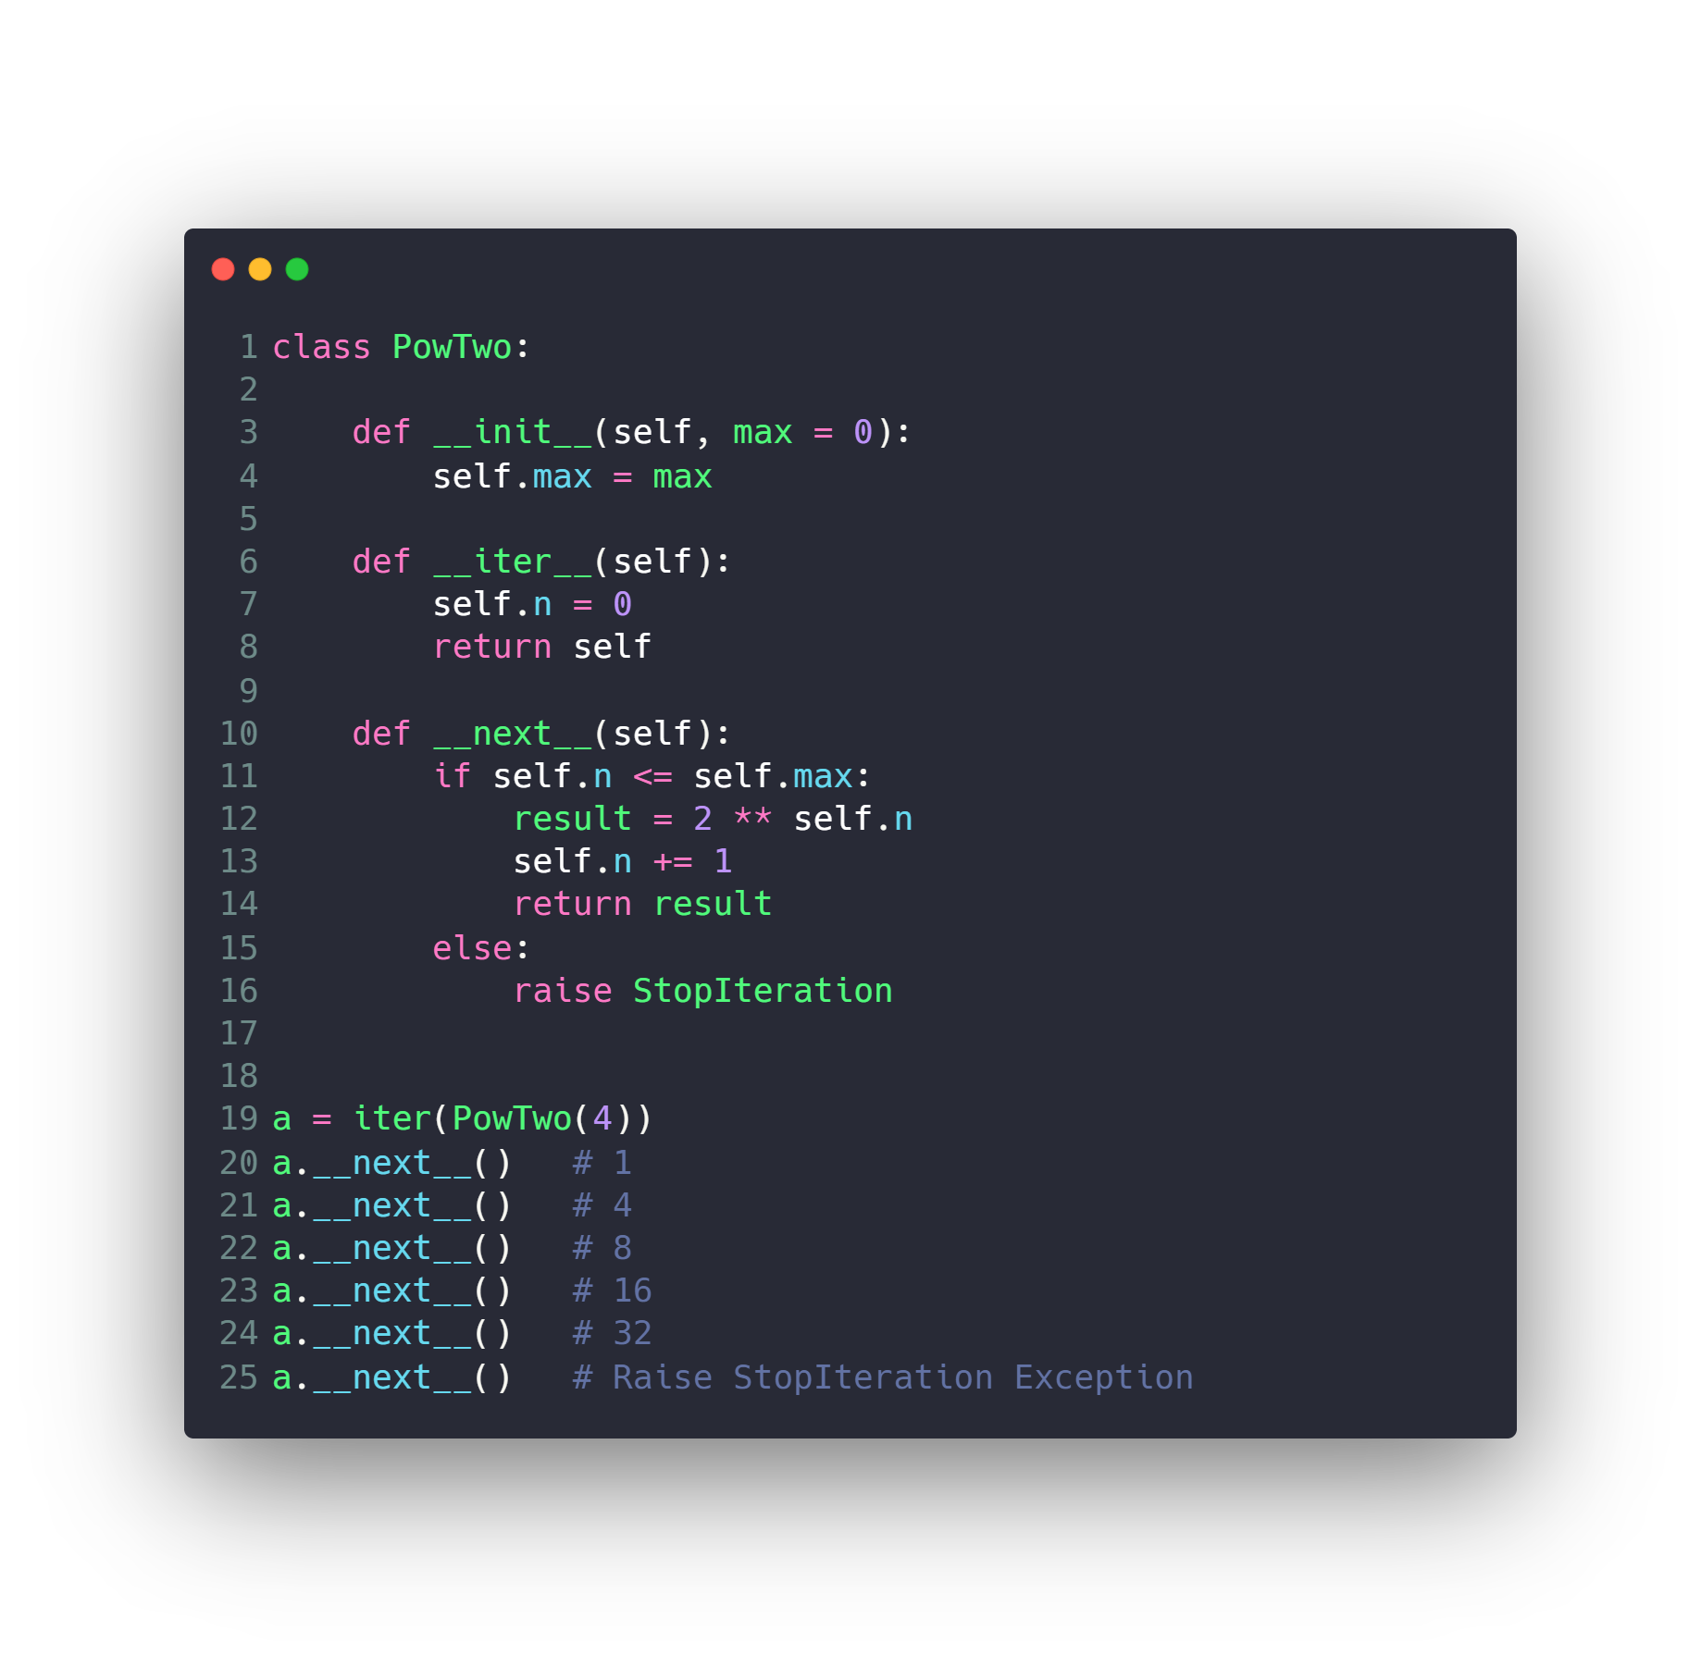
Custom Iterators

Slide 47
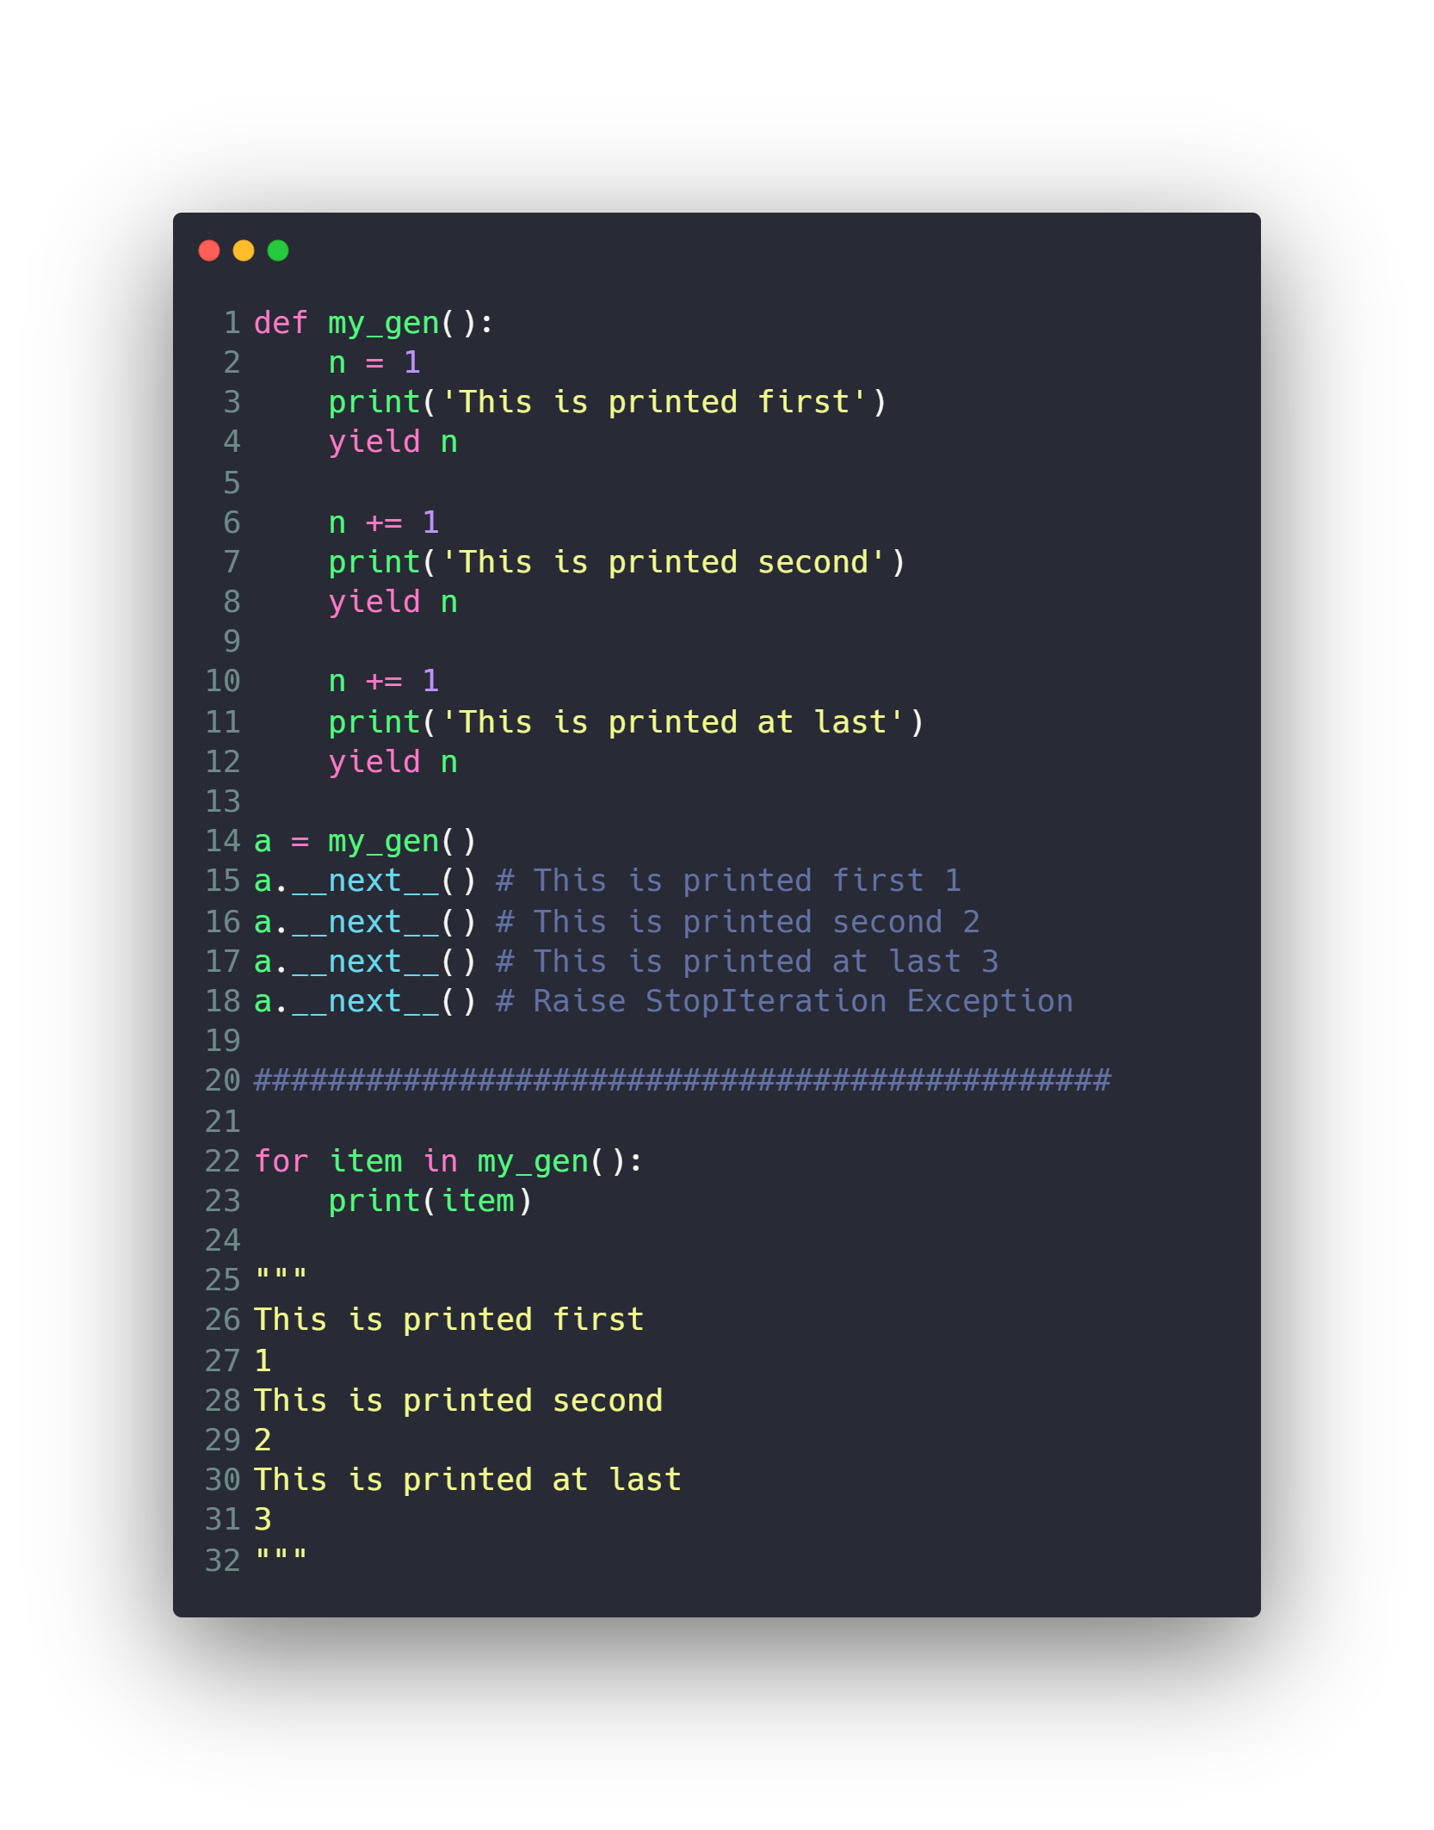
Generator
Much Better
no need to implement __iter()__ and __next__()

Slide 48
Questions ?!

Slide 49

Thanks! >_ Live long and prosper

